Slide 1
Dr. Drone
Revolutionizing Emergency Medical Assistance Through Technology
TEAM ID: TEM1708
Sakthivarshini.K, Nesharajan.S
Email@: sakthivarshini44@gmail.com,nesharajan@gmail.com.
Contact: 9123564018,7010361927

Slide 2
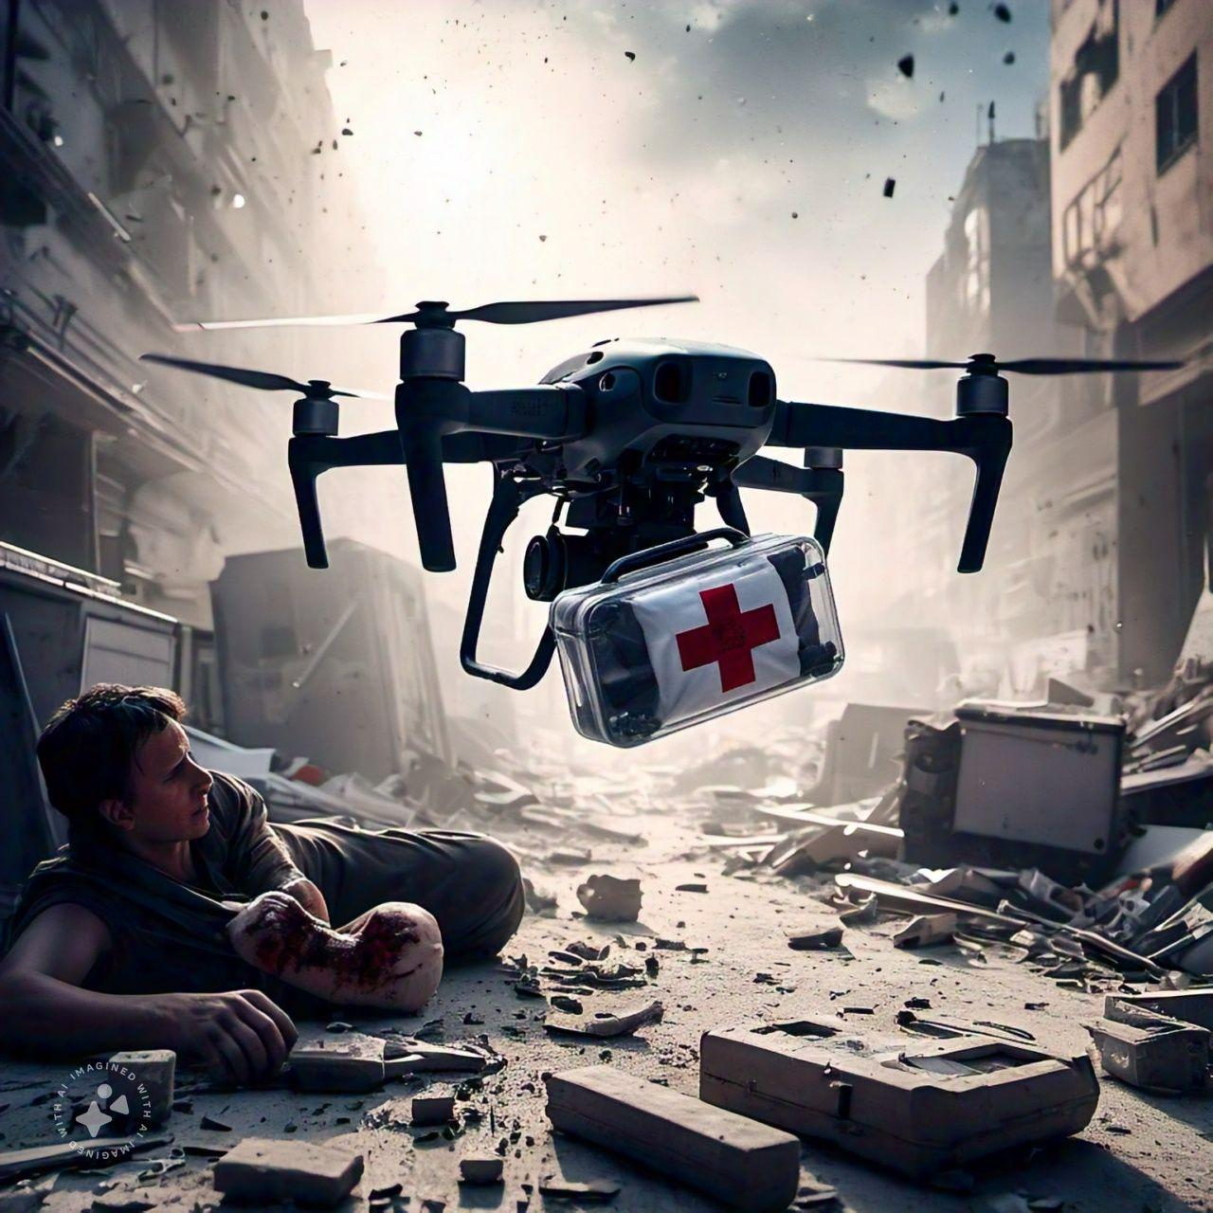
Introduction
To provide timely medical assistance using drone technology and reduce response time in emergencies.

Slide 3
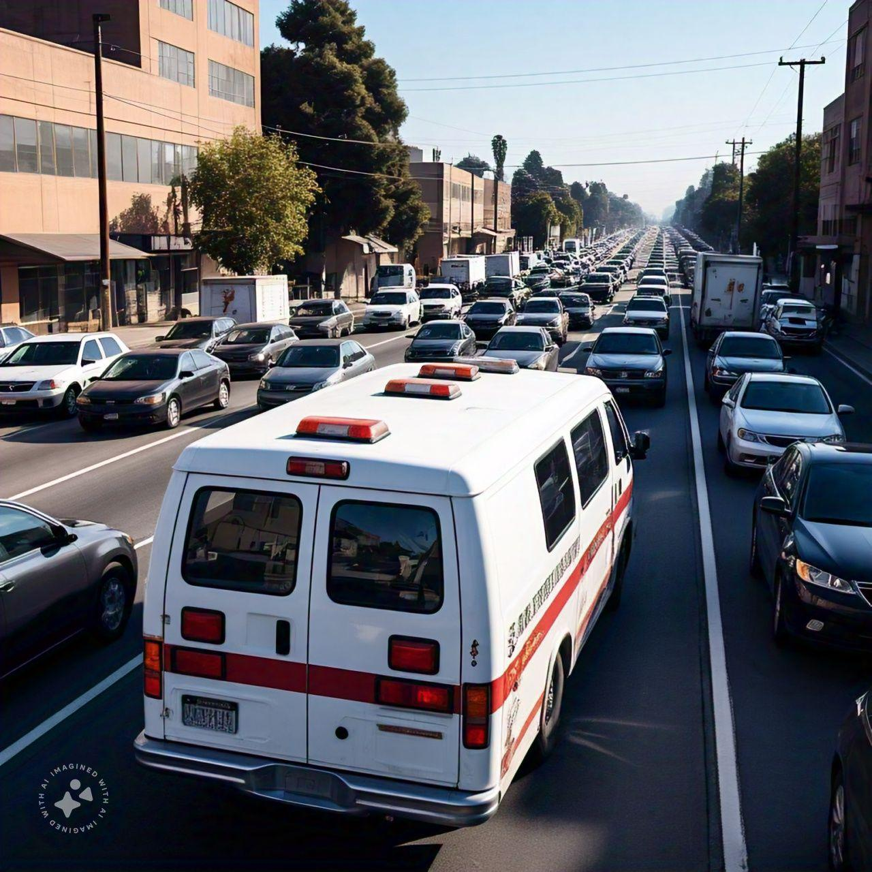
Problem Statement
Challenges in Emergency Response:
Delay in reaching remote or traffic-congested areas.
Lack of immediate medical assistance before professional help arrives.
Risk of worsening injuries due to a lack of first-aid knowledge

Slide 4
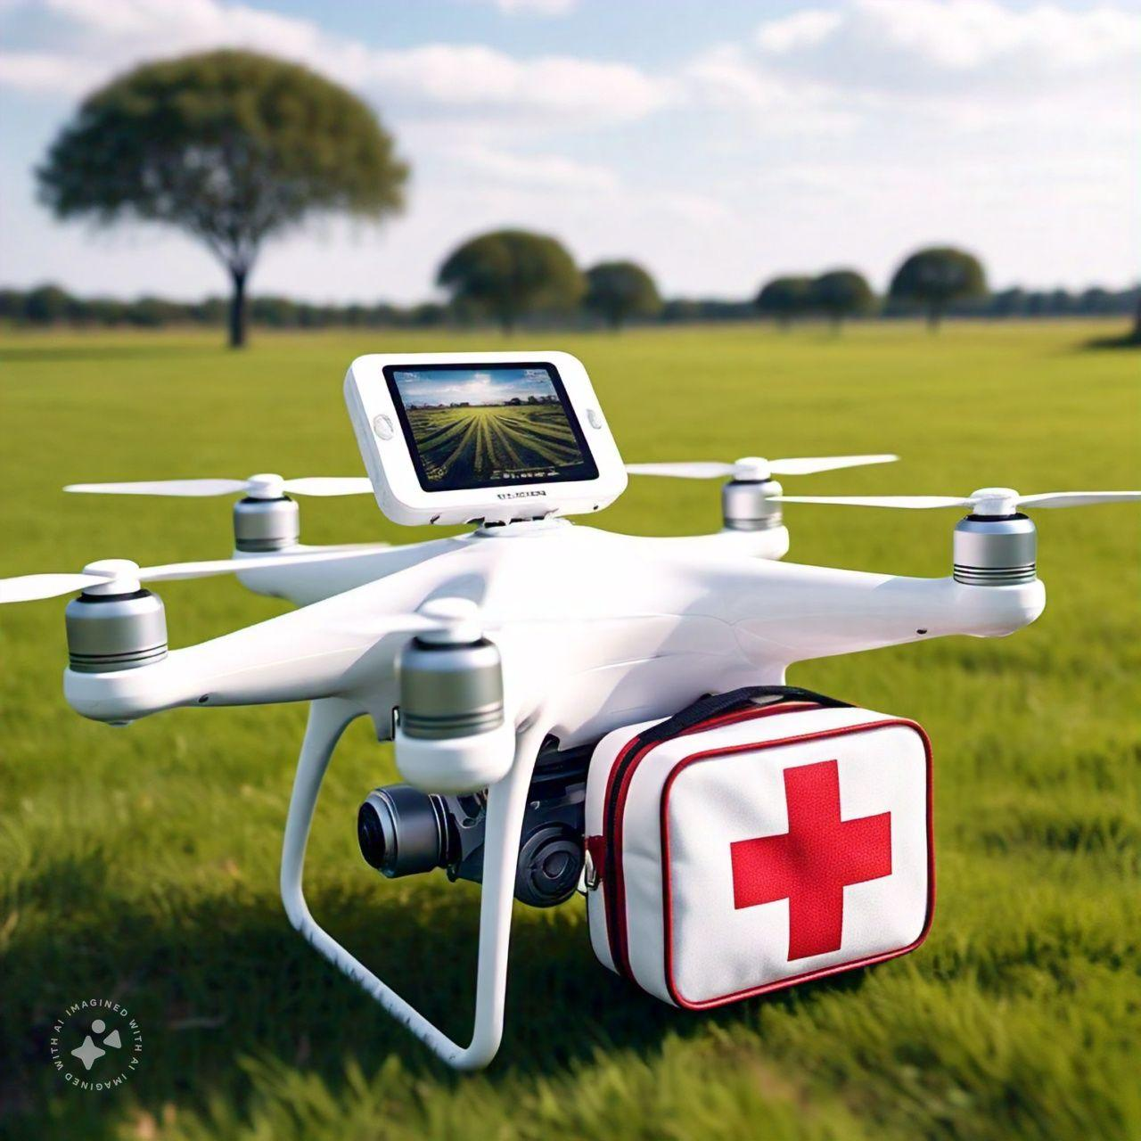
Proposed Solution
Deploy drones equipped with medical kits and communication technology.
Provide live instructions via video calls and instructional displays for administering first aid.
Enable real-time interaction with doctors to guide bystanders.

Slide 5
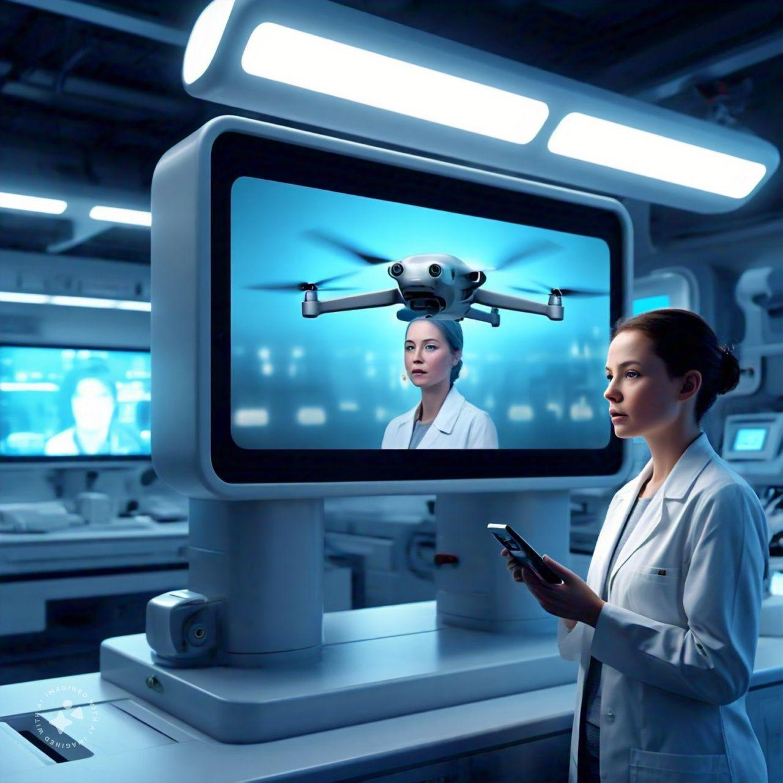
System Architecture
Components:
Drone equipped with medical supplies.
Smartphone application for communication and guidance.
Backend system for hospital communication and doctor coordination.

Slide 6
Technology Used
Drone Technology:
Equipped with navigation and payload capabilities.
Communication Tools:
Video calling and live streaming.
Mobile Application:
User-friendly interface for interaction.
AI Algorithms:
For route optimization and incident prioritization.

Slide 7
Benefits
Rapid Response:
Reduces critical delays in emergency scenarios.
Accessible Assistance:
Brings medical help to remote or congested areas.
Cost Effective
Reduces the need for immediate ambulance deployment in minor cases.

Slide 8
Challenges and Solutions
Challenge: Drone delivery in bad weather.
Solution: Weather-resistant drones and alternate deployment methods.
Challenge: Limited public trust in drones.
Solution: Awareness campaigns and live demonstrations.
Challenge: Regulatory compliance.
Solution: Collaborate with authorities for clear guidelines.

Slide 9
Conclusion
Drone offers a fast, innovative solution to provide immediate medical assistance in emergencies, saving lives by bridging the gap between accidents and professional care through advanced drone and communication technology.

Slide 10
Thank you for your attention!

